Slide 1
IndiaFashion: Ethnic Apparel Classification model
By - Sachin Patel & Sneha Yadav Supervised by - Dr. Alessandra Mileo
Notes:
“Hello Professor. Today, I will be presenting our research on 'Experimenting with IndiaFashion: Indian Ethnic Apparel Classification Model.'

Slide 2
Introduction
Apparel's significance in daily life, reflecting cultural influences.
Diversity of Indian Ethnic apparel.
Gap in categorization systems for Indian Ethnic apparel in e-commerce.
Objective of the research: Enhance clothing categorization for improved user experience
Notes:
We all understand the role of clothing in our lives, not just as a basic necessity, but also as a reflection of culture and identity. Particularly, in a country as diverse as India, the range of clothing styles is immense. However, when it comes to e-commerce platforms, we often find that the categorization systems are skewed towards Western styles. This creates a need for a comprehensive categorization system for Indian Ethnic apparel. Our research aims to bridge this gap and improve the user experience in online shopping."

Slide 3
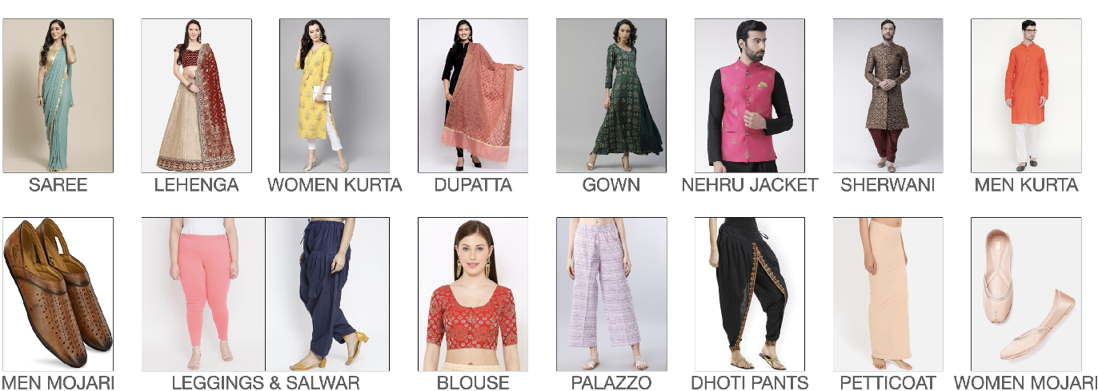
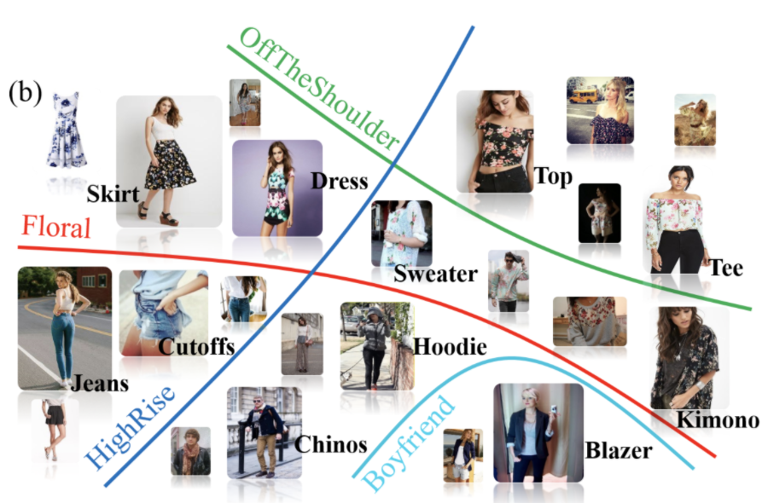
← Sample of Indian Ethnic Apparel
Source: IndoFashion
Sample of Western Clothing →
Source: DeepFashion Dataset | Papers With Code
Notes:
On the left side you can see the sample images of the Indian Ethnic apparel and on the right side is the sample of western clothes

Slide 4
Literature Review
Existing datasets like FashionMNIST and DeepFashion predominantly focus on Western clothing styles.
Atlas Dataset:
Focuses on fabric classification, with apparel details and images.
Includes a small portion of Indian ethnic wear.
Offers insights into e-commerce product categorization and pricing.
Limited depth in its taxonomy tree (three tiers).
Generative Indian Fashion:
Small dataset on Indian fashion (12K images).
Doesn't cover textile classification.
Provides diversity in fashion images but limited in scope.
Notes:
In the literature review, we explored two significant datasets that are relevant to our research on Indian Ethnic apparel classification. The first dataset is the Atlas dataset, developed by Venkatesh Umashankar. It primarily focuses on fabric classification and provides detailed information about apparel, including names, prices, images, and category paths. While the taxonomy of the Atlas dataset largely emphasizes Western clothing, it does include a portion of Indian ethnic clothing. This dataset gives us insights into product categorization and pricing strategies within the e-commerce domain.
The second dataset we reviewed is Generative Indian Fashion. Although it focuses on Indian fashion, its limited size of around 12K images constrains its potential for deep model training. Additionally, this dataset does not address textile classification. Despite these limitations, Generative Indian Fashion contributes to our understanding of Indian clothing styles and provides a diverse collection of images across various categories.

Slide 5
Related Work- IndoFashion Dataset
IndoFashion Dataset:
Created by Shivangi Aneja and team.
106K images from diverse Indian e-commerce sites.
Focuses on Indian ethnic garments (15 categories).
Used for ResNet-based classification model.
Data augmentation improved model performance.
Emphasized dataset quality over complexity.
Our study builds on this foundation, with the use of augmentation techniques and additional classes to delve into the complexities of this culturally rich apparel domain.“
Notes:
The IndoFashion dataset, created by Shivangi Aneja and her team, is a crucial part of our research. It's a big collection of 106,000 pictures taken from different Indian online ecommerce websites. Unlike the other datasets we talked about, IndoFashion focuses on traditional Indian clothes. It covers many different types of clothing, a total of 15 unique classes.
Researchers used the IndoFashion dataset to teach computers how to classify clothes using special models called ResNet. They found that making the dataset bigger and better through various techniques helped the CNN models work better. Surprisingly, the simpler model, ResNet-50, worked even better than the more complex ones. This shows that having lots of good data is sometimes more important than having a super complicated model to get accurate results.

Slide 6
Dataset
Original IndoFashion Dataset:
Total of 106,000 images sourced from various Indian e-commerce websites.
Focused on traditional Indian ethnic garments.
Divided into 15 distinct clothing categories.
Augmented IndoFashion Dataset:
3 additional classes were introduced using web scraping.
Dataset expanded with images of "Men Pagdi“, "Women Anarkali Kurta“, and "Women A-Line Kurta."
Dataset collection process using automated tools (Selenium, Chrome Webdriver).
Data cleaning and curation to ensure dataset accuracy.
Source: IndoFashion
Notes:
The IndoFashion dataset forms the core of our study. What makes this dataset special is that it's all about traditional Indian clothing. These images are grouped into 15 categories based on the type of clothing they show. But we didn't stop with the original dataset. We wanted to make it even better, so we went online and gathered more pictures. We focused on three specific types of clothing: "Men Pagdi," "Women Anarkali Kurta," and "Women A-Line Kurta." These are 1 unique class and two subclasses of the original class Women Kurta of traditional Indian clothing. By adding these new pictures, we made our dataset even bigger and more diverse.

Slide 7
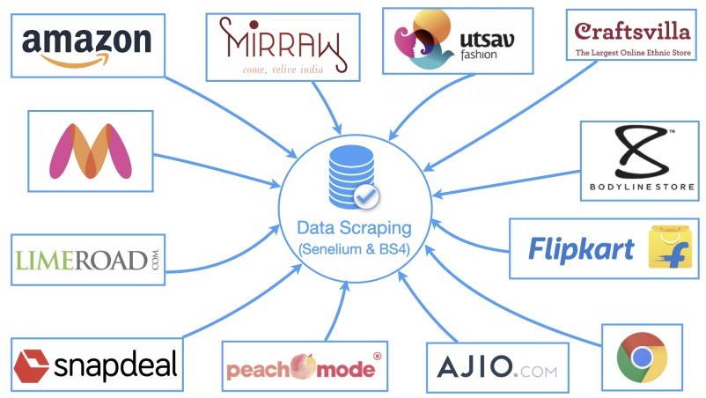
Dataset Collection Sources
Source: IndoFashion
Notes:
We used python scripts with webscraping tools like Selenium and Chrome Webdriver for collecting the image samples from various ecommerce websites and collected samples of three classes: Men Pagdi, Women A-Line Kurta and Women Anarkali Kurta

Slide 8
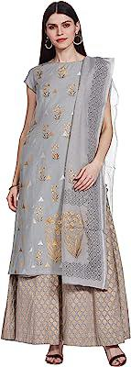
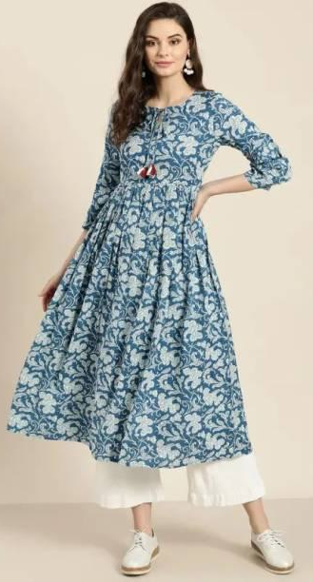
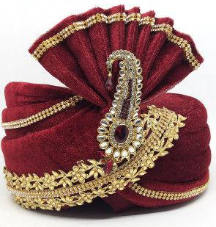
Women A-Line Kurta
Men Pagdi
Women Anarkali Kurta
Notes:
These are the image samples of the three classes:

Slide 9
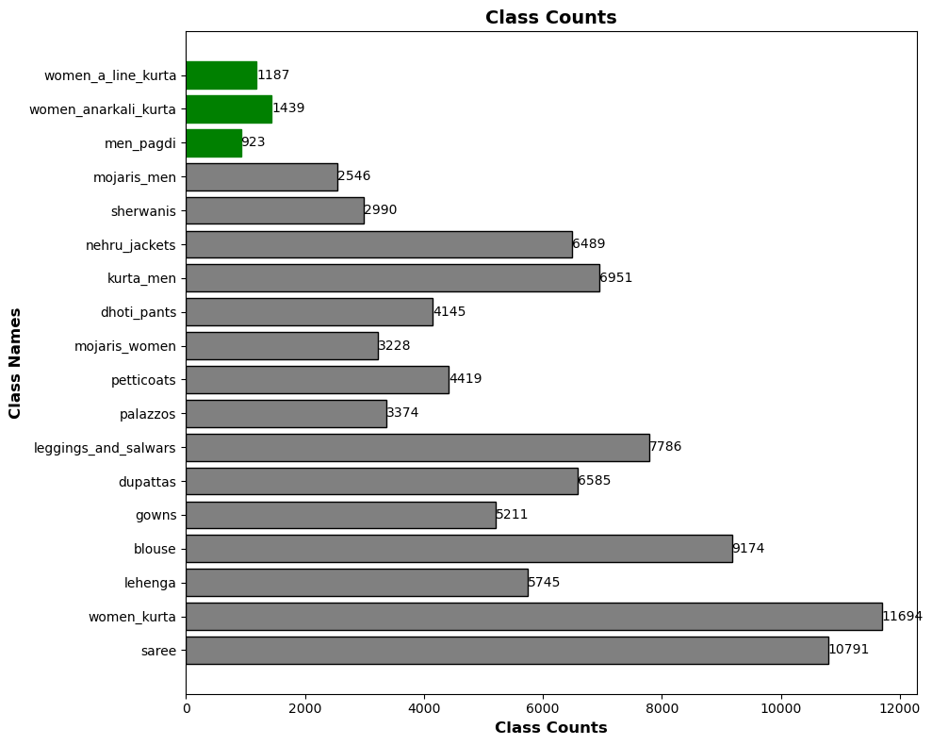
Augmented IndoFashion Dataset Class counts
Notes:
We managed to gather around 1187 image samples of Women A-Line kurta
1439 image samples of Women Anarkali kurta 923 image samples of Men Pagadi

Slide 10
Dataset Statistics
Gender | Categories
Women | Saree, Women Kurta, Leggings & Salwar, Palazzo, Lehenga, Dupatta, Blouse, Gown, Dhoti Pants, Petticoats, Women Mojari, Women Anarkali Kurta, Women A-Line Kurta
Men | Men Kurta, Nehru Jacket, Sherwani, Men Mojari, Men Pagdi
Split | No. of Images
Train | 94677
Validation | 7809
Test | 7808
Notes:
This is our augmented dataset statistics with the additional three classes.

Slide 11


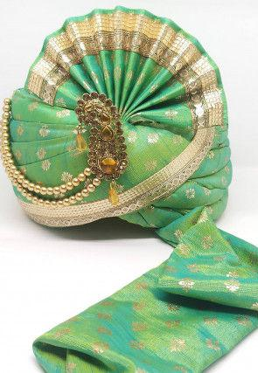
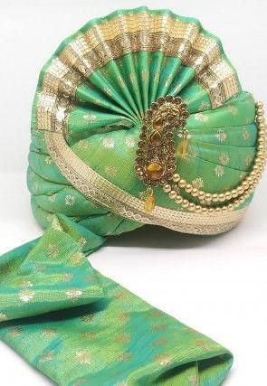

Pipeline
Web
Train Set
Scraping
Data Augmentation Example : Horizontal Flip
Training ResNet-18, ResNet-50, ResNet-101 Model
Dataset Input
Validation Set
Evaluating the trained Model on Test Set
Test Set
IndoFashion
Notes:
This is a block diagram of our experiment.
Web scraping was done for the images from various ecommerce websites and the indofashion dataset was split into into 3 sets and data augmentation was applied and then it was further trained on resnet 18, 50, 101 models and evaluation was done on the test set.

Slide 12
ExperimentS
Approach:
Utilized an augmented IndoFashion dataset with 18 distinct clothing classes.
Used transfer learning method with pre-trained ResNet18, ResNet50, ResNet101
Applied data augmentation techniques.
Notes:
We used a transfer learning approach for building our CNN model. The augmented dataset input was split into a train set, validation set, and test set and further we used data augmentation techniques like Geometric transformation such as (horizontal flip, rotation ) and Colour transformation such as colour jitter. Further, the image samples were normalized to 128x256 pixels. The augmentation is only applied to the training set. Then on the training set the ResNet-18, ResNet-50, ResNet-101 models were trained for 18 classes including the three new classes.

Slide 13
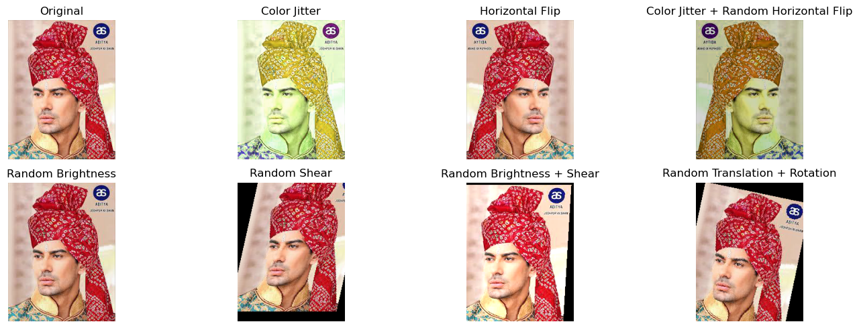
Data augmentation
*Only during the training phase

Slide 14
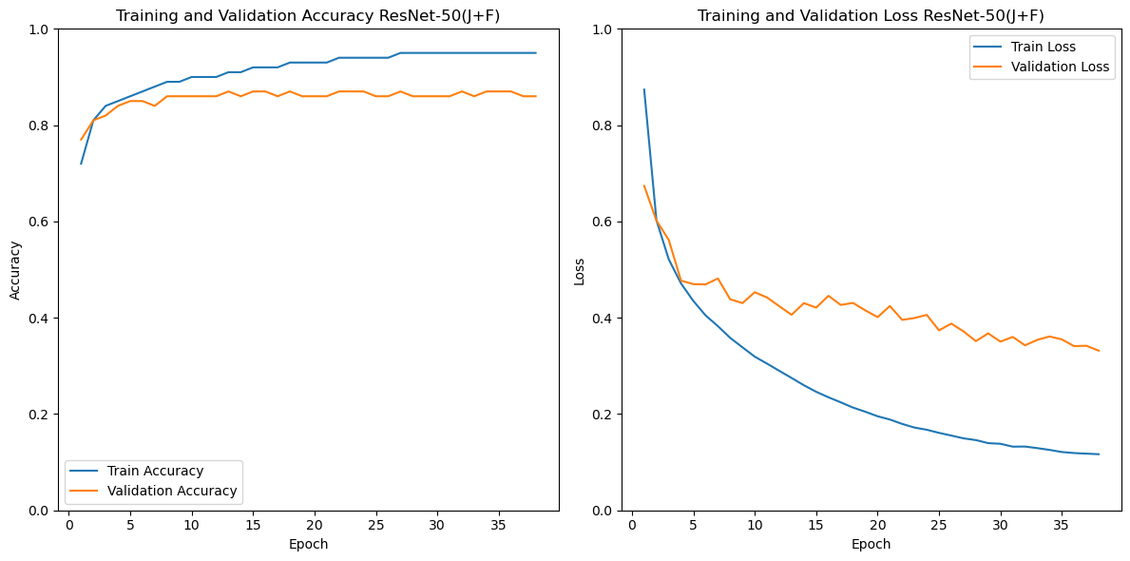
Accuracy and Loss Charts - Resnet-50(J+F)
Both training accuracy increases, and training loss decreases over epochs.
Validation loss is also decreasing, and validation accuracy is increasing but it gets plateau after 15 epochs.
Notes:
As we used ResNet18, 50 and 101 models on the augmented data. This is the The training accuracy increases, and training loss decreases over epochs which indicates that the model is learning from the training data and is becoming more accurate at classifying the images.
The validation loss is also decreasing, and validation accuracy is increasing, but the validation accuracy plateaus after epoch 15. This is a sign that the model is starting to overfit the training data.

Slide 15
Experiment results
Models Trained on 15 Classes of IndoFashion Dataset
Model | Precision | Recall | F1-Score
R-18(NA) | 86.9 | 86.12 | 86.11
R-18(F) | 88.3 | 87.41 | 87.44
R-18(J) | 87.83 | 87.24 | 87.24
R-18(J+F) | 88.62 | 87.52 | 87.46
R-50(NA) | 87.95 | 86.94 | 86.93
R-50(F) | 88.85 | 87.81 | 87.84
R-50(J) | 87.78 | 87.04 | 87.04
R-50(J+F) | 88.93 | 88.42 | 88.38
R-101(NA) | 87.66 | 86.82 | 86.86
R-101(F) | 89.35 | 88.56 | 88.5
R-101(J) | 86.86 | 86.3 | 86.29
R-101(J+F) | 88.63 | 87.97 | 87.94
Models Trained on 18 Classes of IndoFashion Dataset
Model | Precision | Recall | F1-Score | Error Rate
R-18(NA) | 87.58 | 86.83 | 86.92 | 13.17
R-18(F) | 88.99 | 87.81 | 87.81 | 12.19
R-18(J) | 87.22 | 86.14 | 86.17 | 13.86
R-18(J+F) | 88.49 | 87.45 | 87.39 | 12.55
R-50(NA) | 87.41 | 86.48 | 86.37 | 13.52
R-50(F) | 88.78 | 88.08 | 88.03 | 11.92
R-50(J) | 87.17 | 86.35 | 86.4 | 13.65
R-50(J+F) | 89.11 | 88.32 | 88.33 | 11.68
R-101(NA) | 88.06 | 87.03 | 87.01 | 12.97
R-101(F) | 88.18 | 87.22 | 87.27 | 12.78
R-101(J) | 87.21 | 86.33 | 86.29 | 13.67
R-101(J+F) | 88.82 | 88.22 | 88.23 | 11.78
Notes:
In our study, we used pre-trained ResNet models – ResNet18, ResNet50, and ResNet101. These models were then fine-tuned on our custom dataset containing 18 clothing classes.
The left-hand side table shows the metrics of models trained on the original IndoFashion dataset whereas the right-hand side table shows the metrics of models trained on the augmented dataset with 18 classes. We observed that the relatively simpler ResNet18 model yielded better results compared to the models trained on the original IndoFashion Dataset, which had 15 classes.
Our experiments extended to the ResNet50 model, with and without image augmentation. Surprisingly, we found similar F1 scores between these two approaches. Additionally, we further experimented with a more complex ResNet101 model, trained on our modified IndoFashion dataset with 18 classes. And this model also shows similar results. Notably, techniques such as Jitter and Flipping, whether used individually or in combination, consistently enhanced model performance across all ResNet architectures.

Slide 16
Experiment Results
Test Statistics for 3 specific classes (added)
Model | Recall | F1-score | Error Rate
Men Pagdi
R-50(J+F) | 85.19 | 92 | 14.81
Women Anarkali Kurta
R-50(J+F) | 96.06 | 97.99 | 3.94
Women A-Line Kurta
R-50(J+F) | 75.96 | 86.34 | 24.04
Women Kurta
R-50(J+F) | 88.40 | 93.84 | 11.6
Tested ResNet-50(J+F) model on the following 3 classes specifically:
Men Pagdi
Women A-Line Kurta (Sub-class of Women Kurta)
Women Anarkali Kurta (Sub-class of Women Kurta)
Women Kurta
Notes:
As ResNet-50(J+F) was our best-performing model, we took this model to test the specific image samples of the 3 added classes which are 1 unique class “Men Pagdi” and two sub-classes of the main class “Women Kurta” which are “Women Anarkali Kurta” and “Women A-Line Kurta”. We can see that a high F1 score for “Men Pagdi” shows that model can recognize new and distinctive classes very well.
We can also see that a high F1 score of the sub-class “Women Anarkali Kurta” indicates the accurate classification for the fine-grained subclass.
For “Women A-Line Kurta we can see that a slightly lower F1 score shows that fewer image samples impacted the learning of distinct features and shows reduced classification performance.
We also tested the model on existing samples of “Women Kurta” and found it performed well with an F1 score of 93% and it shows that the introduction of the new subclass didn’t affect the main class.

Slide 17
Handling Data Imbalance
Model Generalization and Data Imbalance:
Strong generalization for Men Pagdi and Women Anarkali Kurta
Lower F1-score for Women A-Line Kurta, more samples needed
Dataset's class imbalance poses challenges
Balancing dataset improves model performance and generalization
Handling Data Imbalance:
Computed class weights based on sample counts
Higher weights for underrepresented classes
Used class weights and Weighted Loss Function
Notes:
We're looking at how well the model can work with different categories and the challenge of not having balanced data. We found that the ResNet-50(J+F) model was really good at sorting out "Men Pagdi" and "Women Anarkali Kurta”. But for "Women A-Line Kurta," it slightly performed less, so we need more examples of this subclass. Our augmented dataset has some classes which are having less image sample counts, so our dataset is skewed. To make the model better, we balanced the dataset by giving more importance to classes that didn't have many samples. We did this by changing how the model learns from the data by using class weights and the Weighted Loss Function. This helped the model handle the class imbalance better and learn more effectively.

Slide 18
Handling Data Imbalance (Contd.)
Selection of Base Architecture:
ResNet-50 exhibited the best results among tested models
Chosen as base architecture for exploring augmentation impact
Implementation of Data Augmentation:
Techniques: Random Shear, Random Brightness, Shear and Brightness combination, Translate and Rotate, Jitter and Flip
Implement computed class weights and Weighted Loss Function
Notes:
Since ResNet-50 was our best-performing model, We used the same ResNet50 model and applied compute class weight and weighted loss function with different data augmentation techniques such as Random Shear, Random Brightness, Shear and Brightness combination, Translate and Rotate, and Jitter and Flip.

Slide 19
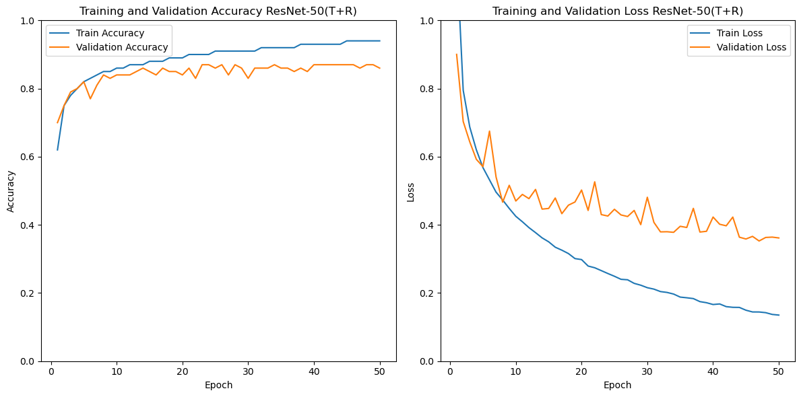
Accuracy and Loss Charts - Resnet-50(T+R)
Notes:
The training accuracy increases, and training loss decreases over epochs which indicates that the model is learning from the training data and is becoming more accurate at classifying the images.
As we can see validation loss is also decreasing, and validation accuracy is increasing, but the validation accuracy plateaus after epoch 25. This is a sign that the model is starting to overfit the training data. The best model was saved.

Slide 20
Experiment Results
Models trained on 18 classes of IndoFashion Dataset
Model | Precision | Recall | F1-score | Error
R-50(S) | 87.05 | 86.58 | 86.57 | 13.42
R-50(B) | 87.42 | 86.76 | 86.79 | 13.24
R-50(B+S) | 88.00 | 87.73 | 87.72 | 12.27
R-50(T+R) | 88.32 | 88.26 | 88.25 | 11.74
R-50(J+F) | 87.9 | 87.62 | 87.61 | 12.38
Evaluated models with different augmentation techniques
S – Shear B – Brightness T – Translate R – Rotate J – Colour Jitter F – Flip
Notes:
The table shows the test results of the ResNet-50 model with different data augmentation techniques. The model with translate and rotate augmentation techniques performed better than others with an F1 score of 88.25%.

Slide 21
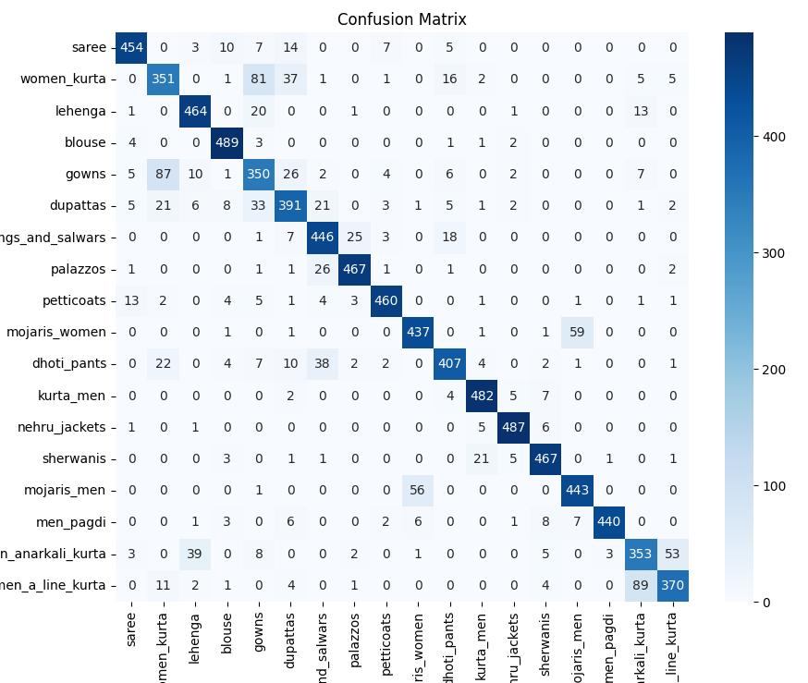
Confusion Matrix
Key Observations:
There was little confusion between Anarkali Kurta and A-Line Kurta as these two are subclasses of Women Kurta which are visually similar.
Model successfully classified Men Pagdi which is a unique class.
Notes:
We tested our latest ResNet-50(T+R) model on test dataset with atlest 500 samples of each class and found that model successfully classified “Men Pagdi” class and two sub-class “Women Anarkali kurta” and “Women A-Line Kurta”.

Slide 22
Key Findings
Geometric transformation of flip + Jitter and Translate + Rotate were useful in increasing the model performance & generalization.
Others can utilise our pipeline to further add a new class or subclass in the dataset.
Handling Class Imbalance using Calculated Class Weights and Weighted Loss.
Extension of the existing IndoFashion dataset.
Notes:
From this project, we learnt that data augmentation helps in increasing model performance and model generalization.
We proposed a pipeline using which other researchers can add a new class or sub-class in the dataset. We handled the class imbalance using class weights and weighted loss function.
And in the end, we extended the existing IndoFashion dataset.

Slide 23

Conclusion
Improved model recognition of diverse categories.
Challenges in subclass classification, highlighting the need for a larger sample size.
Applied data augmentation techniques to address class imbalance and enhance model generalization.
ResNet-50(T+R) model achieved the best performance.
Notes:
This concludes our study on Indian Ethnic Apparel Classification using the IndoFashion dataset. We expanded the dataset by introducing new classes. The outcome was a notable enhancement in the model's ability to recognize different categories. However, there was a challenge in subclass classification. Our application of data augmentation techniques effectively handled class imbalance and improved the model's ability to generalize. The ResNet-50(T+R) model was our best performing model.

Slide 24
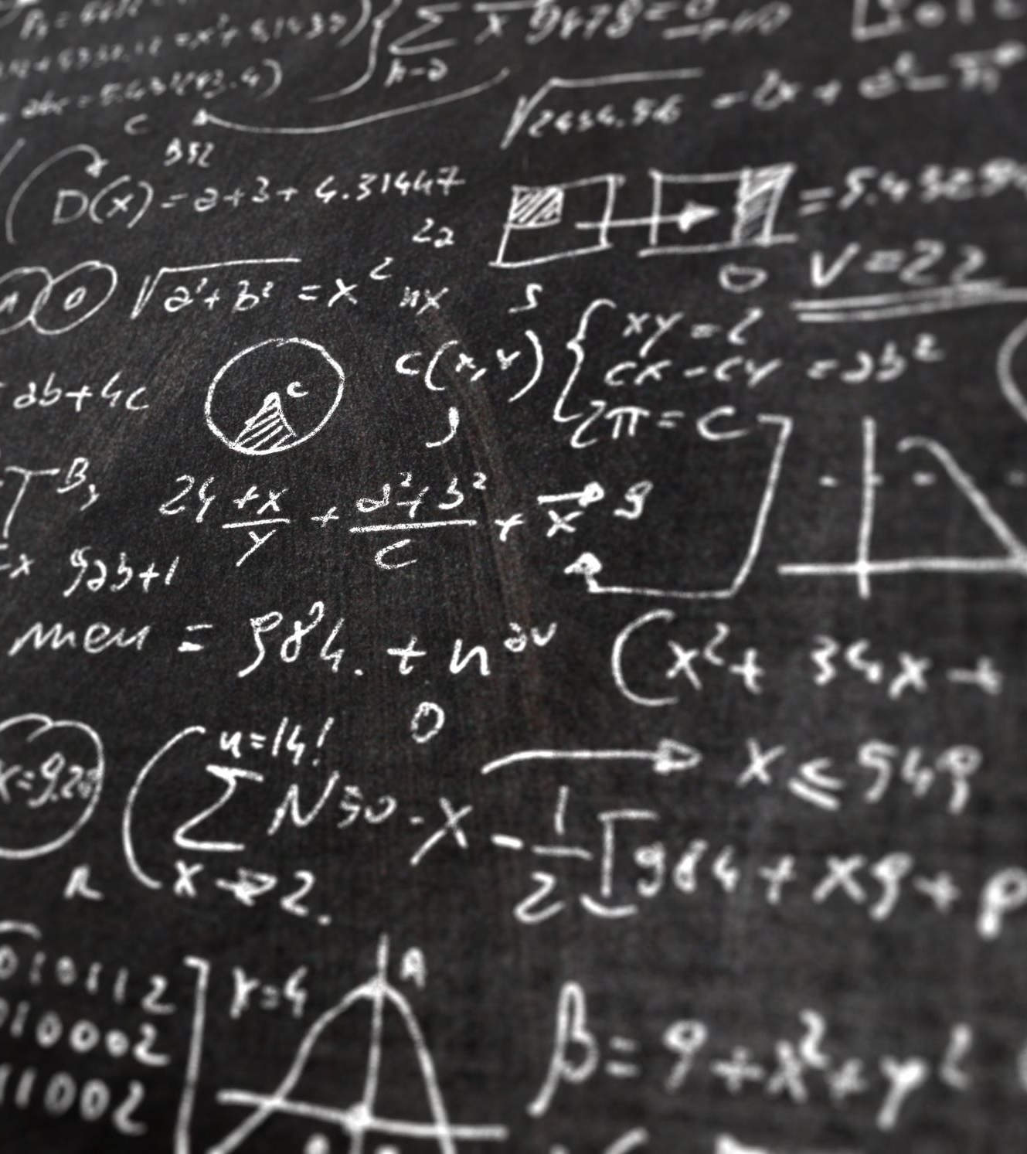
Future Work
Plans to address challenges in subclass classification.
Use of advanced techniques like domain adaptation and ensemble learning.
Expansion of the dataset to incorporate more diverse classes.
Notes:
As for future work, one can explore other methods to address subclass classification. Or use of advanced techniques like domain adaptation and ensemble learning. And dataset can be expanded to include more diverse classes.

Slide 25
Thankyou
References:
IndoFashion: Apparel Classification for Indian Ethnic Clothes https://arxiv.org/pdf/2104.02830.pdf
DeepFashion2: A Versatile Benchmark for Detection, Pose Estimation, Segmentation and Re-Identification of Clothing Images https://arxiv.org/pdf/1901.07973v1.pdf
Atlas: A Dataset and Benchmark for E-commerce Clothing Product Categorization 1908.08984.pdf (arxiv.org)
Generative Fashion for Indian Clothing Generative Fashion for Indian Clothing (harshiljain.in)

